Slide 1


Pacific Cascade MS PTSA
Membership Meeting
November 15, 2018

Slide 2

Agenda
Secretary’s Report
School Leadership Report
Officers’ and Directors’ Reports
Parent Ed: Bystander Intervention Training, Dr. Dana Bailey

Slide 3
Secretary’s Report
Approval of minutes from Sept. 20, 2018 membership meeting
Awards Committee forming now

Slide 4
School Leadership Report
Report from Principal Dana Bailey

Slide 5
President’s Report
District has been spending about $39 million of McCleary money – see “Issaquah School District Major Budget Drivers for 2018-19” (handout)
High School Schedule Committee

Slide 6
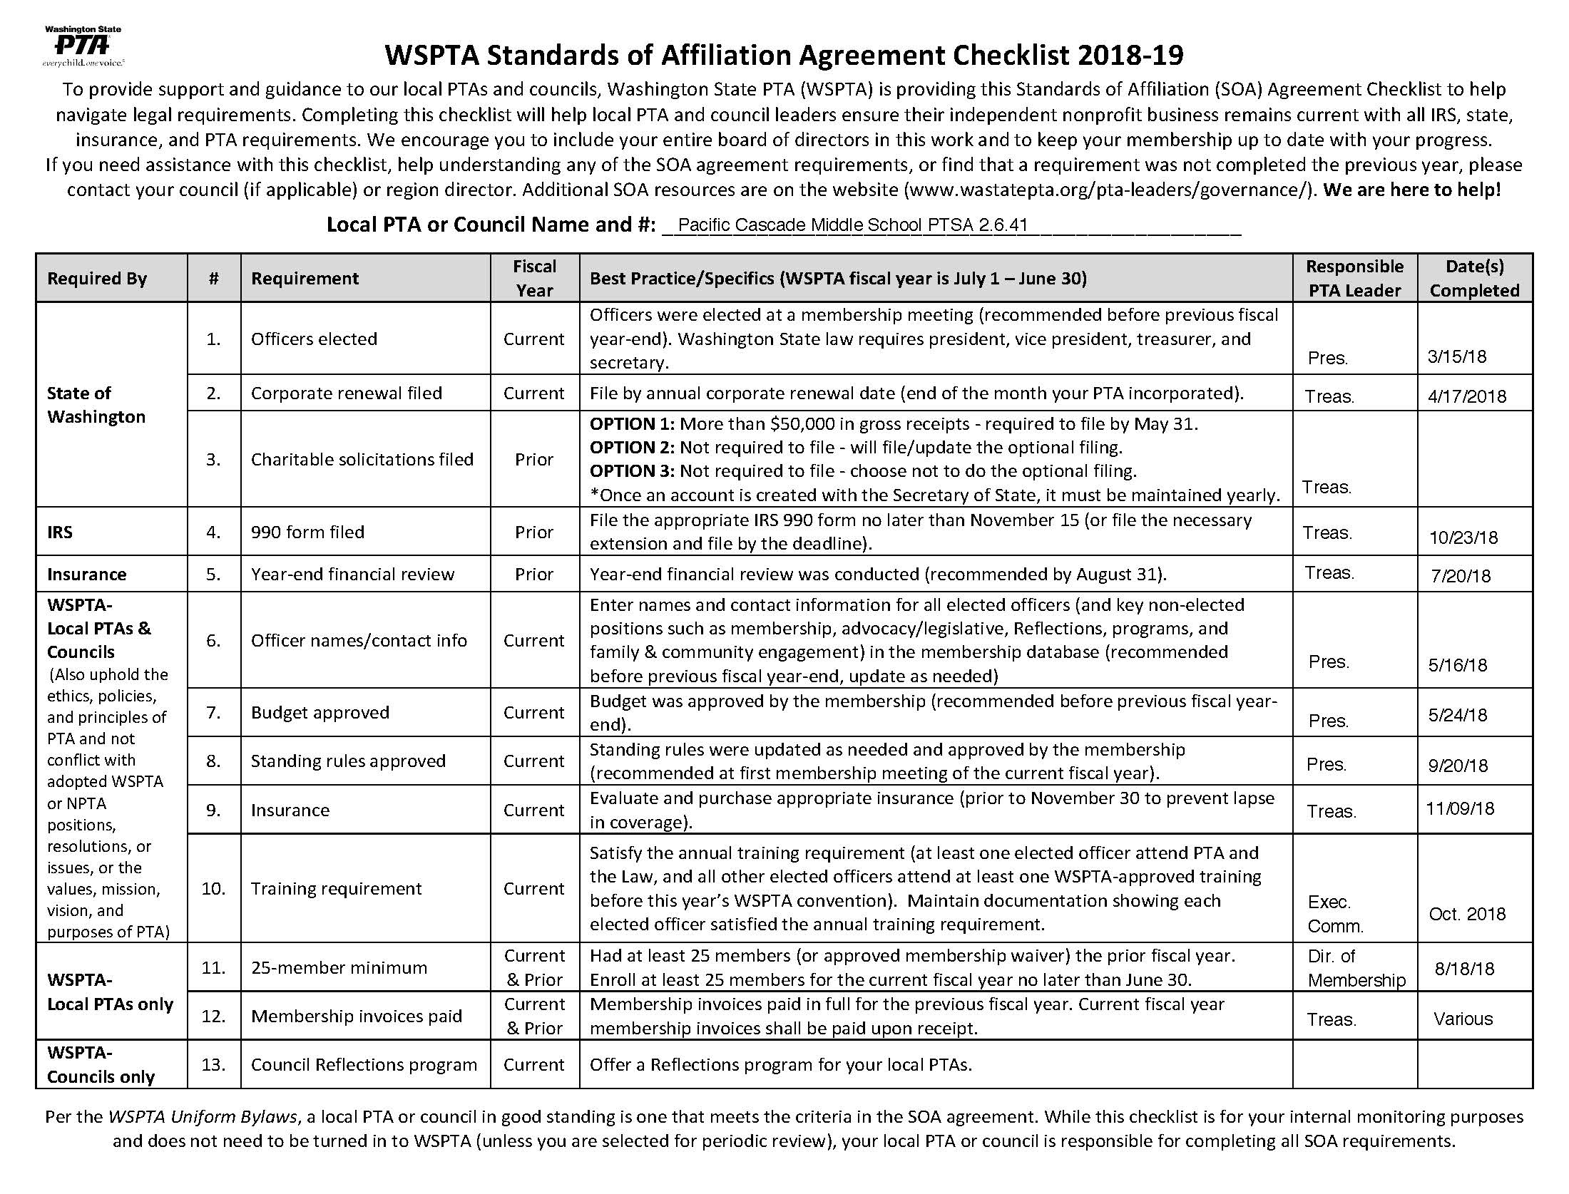
President’s Report

Slide 7
Treasurer’s Report
September/October Highlights:
Income primarily from Membership, Donations and Corporate Matching
Expenses paid include:
  Yearly Council Fees
  PTSA Membership Fees
  Donations to VIS, ISF, Echo Glen, ACT
  Curriculum Enrichment Grants (approved at September General Membership Meeting)
Annual Tax Return Filed

Slide 8
Treasurer’s Report
Bank statements opened and reviewed by a non-signer on the account
AIM Insurance renewed and paid on Nov. 9, 2018
No claims filed against insurance in Sept. or Oct.
  PLEASE SIGN UP TO HELP WITH MID-YEAR FINANCIAL REVIEW!!

Slide 9
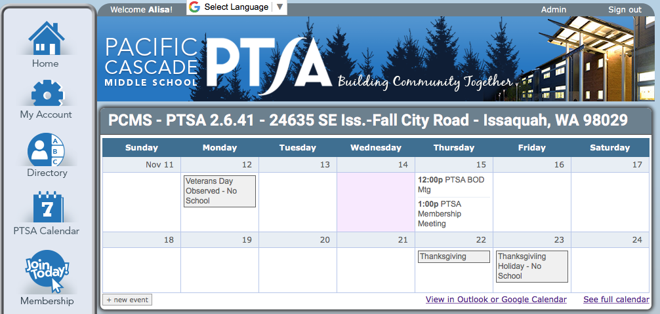
Membership
Member Enrollment – CY 723 / PY 753
Membership Percentage – 72% (1,010 students)
Online Student Directory has been updated – must be a member to access this benefit

Slide 10
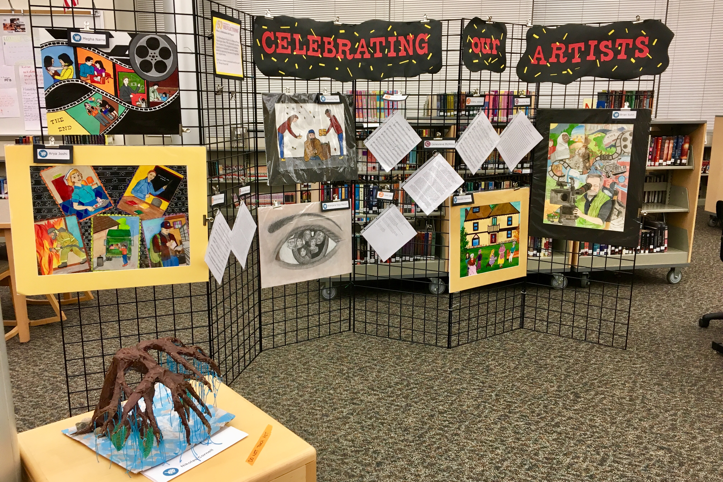
Programs
Reflections
15 student entries
  7 Visual Arts
  4 Literature
  3 Music Composition
  1 Photography
12 Finalists will move on to District
PCMS Reception & Art Showcase was Nov. 14
Council Reception will be Jan. 15, 2019, from 6:30-8:00pm at Issaquah High School
Thank you to our amazing Chair Angela Bizzari!!

Slide 11

Programs
Holiday Gift Barn
Drop off days will be
announced shortly;
items will be delivered
to Pickering Barn on
Dec. 3 & 4
Greatest need is gifts for ages 9-18

Slide 12
ASB/Lynx Life
PTSA provided major support for ASB activities in October!
Popcorn/Cookie Dough Fundraiser – September 25th, and October 2nd,9th & 29th
15 Volunteers, 14 Hours
Collected order forms, counted and recorded money from orders
Halloween Social – October 31st
50 Parent Volunteers & Donors, 12 Hours
Provided more than 40 Costco size boxes of chips, granola bars, rice krispie treats, plus unfrosted cookies, frosting, and sprinkles

Slide 13
Volunteers
School activities supported by PTSA this Fall:
Picture Retake Day – October 18th
4 Volunteers, 8 Hours
Checked in students that needed their pictures retaken
Library Volunteers – Ongoing
10 Volunteers, 31 Hours
Helped with shelving, sorting and processing Library books
Lunchtime Walkabout Volunteers – Ongoing
3 Volunteers, 6 Hours
Parent supervision during the three lunch periods
Vision & Hearing Screening – November 2nd
14 Volunteers, 28 Hours
Conducted hearing screenings, student flow management, and recorded data collection

Slide 14
Advocacy
The new 2019-21 WSPTA Legislative Platform:
Top 5 Legislative Priorities
Social Emotional Learning
School Construction and Simple Majority for Bonds
Prevent Gun Violence
Strategies to Address the Teacher Shortage
Strategic Investments to Close Gaps
Also support issues (listed alphabetically)
Best Practices for School Meals – Lunch
Best Practices for School Recess
Engaging Families in Student Success
Fund Paraeducator Training
Increase Access to High Quality Preschool
Raise the Age of Tobacco and Electronic Nicotine Delivery Systems to 21
Safe School Plans and Emergency Preparedness
Read the full recap of the 2018 WSPTA Legislative Assembly at:
https://www.wastatepta.org/40th-annual-wspta-legislative-assembly-wrap/

Slide 15
Outreach
Homework Help Opportunity
  Does your student need homework help? Get free tutoring at King County Library Study Zone. The Study Zone is a place for K-12 students to study, do homework, and get help with their questions from volunteer tutors. You do not need to register and it is FREE. Check out the schedule at: https://kcls.org/study-zone/
Lunch for the Break
  Winter break poses a unique challenge for families that
  rely on free or reduced-price school lunches. “Lunch for
  the Break” is a program designed to help fill the food gap
  for kids during this time. You can help by donating a box
  (or two, or three). Fill your own box using the standardized shopping list, purchase a pre-made box, or simply make a financial contribution to help purchase perishables. Donor drop off is on Monday, December 17th. Visit Issaquah Food & Clothing Bank to register and for more information: https://www.issaquahfoodbank.org/lunchforthebreak

Slide 16
Parent Education
Parenting with Identity in Mind with Rosetta Lee
January 23, 2019 11:30 AM
Rosetta Lee, a highly-regarded, local and national expert in diversity, inclusion and equity will discuss parenting with identity in mind. Learn how to create positive self-identity in our children and teach them to be positive influences on others. The goal is to create inclusive communities which support everyone’s success.
For parents of children of all ages.
Presented in partnership with Friends of the MI Library.
Mercer Island Community and Event Center, 8236 SE 24th Street, Mercer Island, WA 98040

Slide 17

Issaquah Schools Foundation
Program Spotlight
Did you know that the Foundation funds several programs that help PCMS students with Science, Technology, Engineering, and Math?
Robotics Club competes in local and regional competitions, with the possibility of advancing to the world competition.
STEMPosium is an annual after school community event showcasing how to gain STEM skills and knowledge through exhibits from STEM related industries, classroom projects, afterschool clubs, and student competitions. Stay tuned for 2019 date!
Dining for Kids Take a break from cooking AND support the Foundation!
December 5 – Chinoise Sushi & Asian Grill in Issaquah Highlands
January 2 – Zeeks Pizza in Issaquah Highlands
February 6 – Tanoor (Middle Eastern) in Sammamish
March 6 – Ohana (Hawaiian) on Gilman Blvd in Issaquah

Slide 18
New Business
Volunteer Opportunities
Awards Committee
Nominating Committee
  PCMS PTSA is currently looking for three or more people to serve on the Nominating Committee for the 2019/20 Executive Committee.
  The Nominating Committee will seek out nominees for the elected board positions and present a slate of candidates to the membership at the March PTSA membership meeting. Members of the Nominating Committee must be elected by the PCMS PTSA membership. Committee members must have been a member of the PCMS PTSA or a local PTA in the Issaquah Council for at least 30 days preceding their election.
  If you are interested in serving on the Nominating Committee, please contact the President.

Slide 19
Parent Education
Bystander Intervention Training
Dr. Dana Bailey

Slide 20
Adjourned.
Thank you for coming!

